Slide 1

BHAGWAN PARSHURAM INSTITUTE OF TECHNOLOGY
REAL-TIME SPEED ANALYZER
Minor PROJECT(2021-2022)
GROUP NO.-37
Group Mentor :-
Ms. Richa Sharma
Group Members :-
Vaishali Garg(CSE-B-79)
Kritika Sharma(CSE-B-112)
Kunal Sharma(CSE-B-120)
Urvashi Dhangar(CSE-B-136)

Slide 2
CONTENTS
INTRODUCTION
PROBLEM STATEMENT
FEASIBILITY STUDY
OBJECTIVES
PROPOSED ARCHITECTURE
DFD 0
DFD 1
FUTURE SCOPE
CONCLUSION
REFERENCES

Slide 3
INTRODUCTION
Recently aggressive driving has been a great subject for study and research as it is directly correlated to accidents. It includes excessive speeding, sudden lane changes, and hard breaks. The high-speed limits are often the cause of accidents leading to serious injuries and death. The speed limit should be in control so that we can avoid accidents caused by high-speed driving. Speed thrills but kills. The old traffic fine for speeding was Rs.400 but as per new traffic rules, the fine for speeding is Rs.1000 for LMV and Rs.2000 for Medium Passenger Vehicle[1]. In order to avoid violation of max speed and speed tickets, we propose to create an application that addresses the problem of speed detection using the GPS measurements (distance and time elapse) owned by the users/drivers in the vehicles and will generate voice messages for speed alerts.[2]

Slide 4
Problem Statement
The aim of our project is to predict vehicle speed using smartphone GPS, and alert users at various speed levels set by them. The alert of the speed limit will be given using a dynamic voice message at a regular interval of time till the user reduces/decreases the speed. The major problem in this approach is that we will be using smartphone GPS which is less efficient as compared to professional GPS. Apart from this, we will be adding weather conditions and temperature specifications as per the user’s current location.

Slide 5
objectives
Using smartphone GPS for calculation of real-time speed of user’s vehicle
Implementation of audio alert system
Applying dynamic audio alert system in order to inform the user of current speed
Creating an interface to display speed and weather details to the user
Creating a user-friendly application

Slide 6
Feasibility study
The major challenges we face when we came across this idea were finding the best suitable way both in terms of efficiency and cost. The approaches we looked for:
Hardware components like IoT, Arduino, etc.
Dashboard Camera(processing video frame by frame)
Optical Flow(extraction from live video footage)

Slide 7
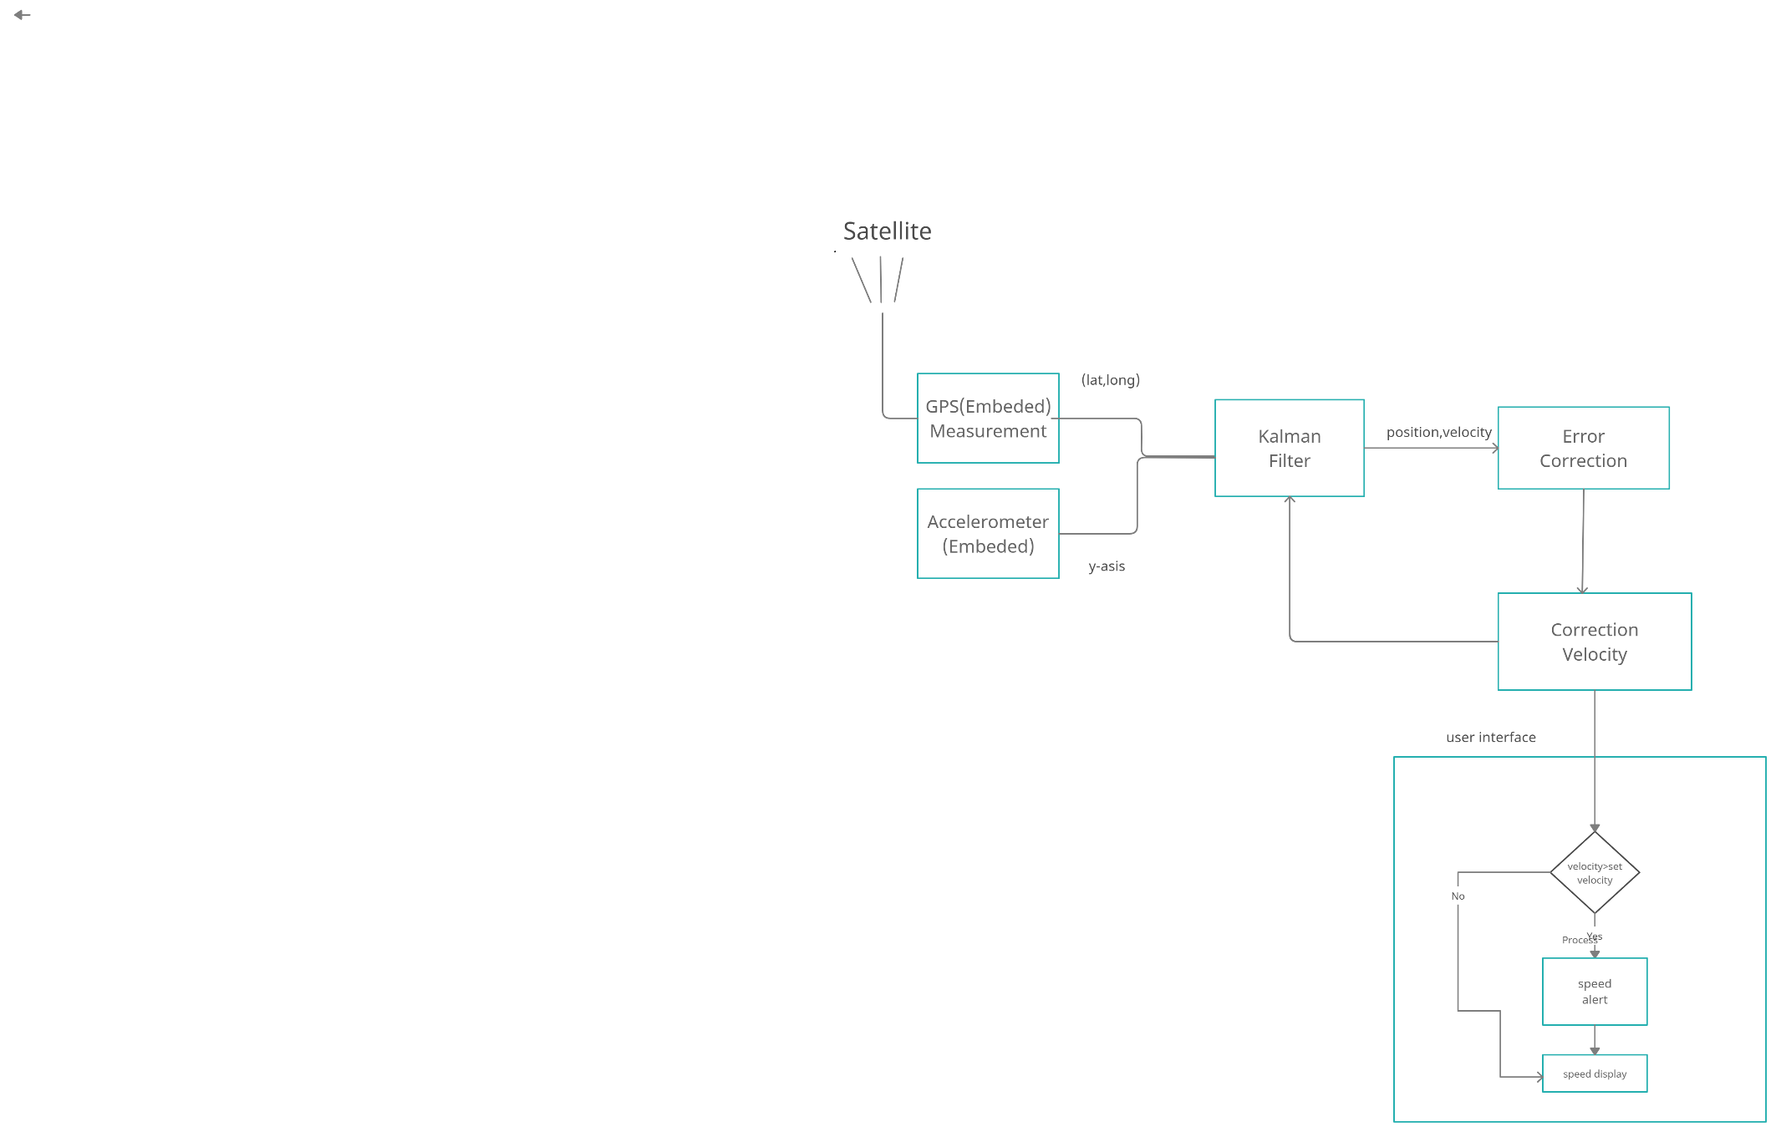
Proposed architecture

Slide 8
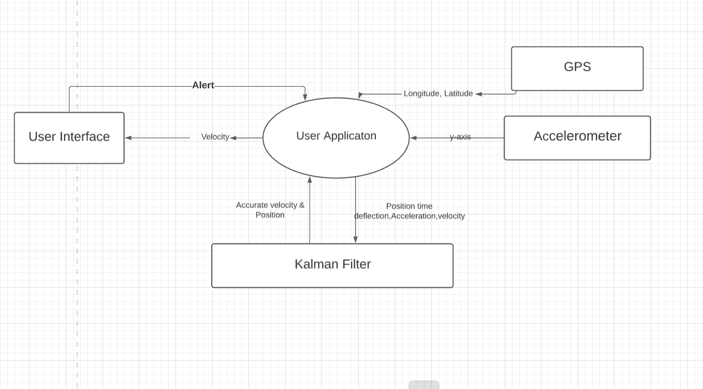
Dfd 0

Slide 9
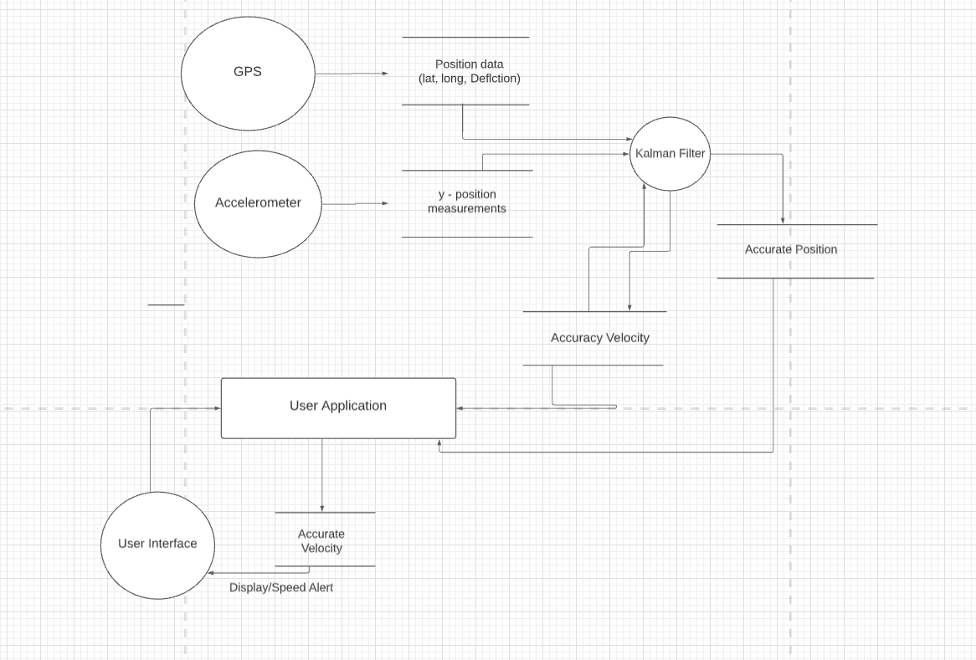
Dfd 1

Slide 10
FUTURE SCOPE
Dynamic alert voice messages at limits(defined by google maps at that area) exceed(tracking using Google maps)
Applying ICP(Iterative Closest Point) map-matching algorithm
Taking application offline(optional)
Making application platform independent

Slide 11
CONCLUSION
This project is all about predicting vehicle speed using smartphone GPS, and alert users at various speed levels. The idea of alert is followed by dynamic voice message at reaching a speed limit at regular intervals of time till the user reduces the speed. Here, in this project we also used GPS to calculate the speed and also tackle the error of finding position of user through Kalman Filter. This project can be further enhanced by including dynamic alert voice messages at limits and applying ICP(Iterative Closest Point) map-matching algorithm by which we can make our application more efficient.

Slide 12
REFERENCES
https://www.policybazaar.com/motor-insurance/two-wheeler-insurance/articles/new-traffic-rules-hefty-traffic-violation-fines-to-be-imposed/
https://ieeexplore.ieee.org/document/6974444
CITATIONS
Aziz, T., Faisal, T. M., Ryu, H. G., & Hossain, M. N. (2021). Vehicle Speed Control and Security System. In 2021 International Conference on Electronics, Information, and Communication (ICEIC) (pp. 1-4). IEEE.
Lattanzi, E., & Freschi, V. (2021). Machine Learning Techniques to Identify Unsafe Driving Behavior by Means of In-Vehicle Sensor Data. Expert Systems with Applications, 176, 114818.
Kang JM, Kim HS, Park JB, Choi YH. An Enhanced Map-Matching Algorithm for Real-Time Position Accuracy Improvement with a Low-Cost GPS Receiver. Sensors. 2018; 18(11):3836. https://doi.org/10.3390/s18113836
Merry, K., & Bettinger, P. (2019). Smartphone GPS accuracy study in an urban environment. PloS one, 14(7), e0219890.
Feng, K., Li, J., Zhang, X., Zhang, X., Shen, C., Cao, H., ... & Liu, J. (2018). An improved strong tracking cubature Kalman filter for GPS/INS integrated navigation systems. Sensors, 18(6), 1919.

Slide 13
Citations cont.
Lohrer, J., & Lienkamp, M. (2016). An approach for predicting vehicle velocity in combination with driver turns. Automotive and Engine Technology, 1(1), 27-33
Reddy, N. R., & Subhani, S. (2019). Monitoring Vehicle Speed using GPS and Categorizing Driver.
Hua, S., Kapoor, M., & Anastasiu, D. C. (2018). Vehicle tracking and speed estimation from traffic videos. In Proceedings of the IEEE Conference on Computer Vision and Pattern Recognition Workshops (pp. 153-160).
Shukla, D., & Patel, E. (2013). Speed determination of moving vehicles using Lucas-Kanade Algorithm. International Journal of Computer Applications Technology and Research, 2(1), 32-36.
Yu, J., Zhu, H., Han, H., Chen, Y. J., Yang, J., Zhu, Y., ... & Li, M. (2015). Senspeed: Sensing driving conditions to estimate vehicle speed in urban environments. IEEE Transactions on Mobile Computing, 15(1), 202-216.

Slide 14
Citations cont.
Chowdhury, A., Chakravarty, T., & Balamuralidhar, P. (2014, October). Estimating true speed of moving vehicle using smartphone-based GPS measurement. In 2014 IEEE International Conference on Systems, Man, and Cybernetics (SMC) (pp. 3348-3353). IEEE.
Laghari, S. M. N. U. Z., & Farrukh, M. A. M. GPS Estimation using Kalman Filter.
Ustun, I., & Cetin, M. (2019). Speed estimation using smartphone accelerometer data. Transportation research record, 2673(3), 65-73.
Yu, J., Zhu, H., Han, H., Chen, Y. J., Yang, J., Zhu, Y., ... & Li, M. (2015). Senspeed: Sensing driving conditions to estimate vehicle speed in urban environments. IEEE Transactions on Mobile Computing, 15(1), 202-216.
Tamilselvan, K., Murugesan, G., & Suthagar, S. (2018). Android Based Vehicle Speed Control System In Critical Zones Using GPS Technology. International Journal of Advanced Research in Electronics and Communication Engineering (IJARECE), 1(6).

Slide 15
Citations cont.
ÖZDEMİR, Z., & TUĞRUL, B. (2019, October). Geofencing on the Real-Time GPS Tracking System and Improving GPS Accuracy with Moving Average, Kalman Filter and Logistic Regression Analysis. In 2019 3rd International Symposium on Multidisciplinary Studies and Innovative Technologies (ISMSIT) (pp. 1-6). IEEE
Li, Z., Wang, R., Gao, J., & Wang, J. (2018). An approach to improve the positioning performance of GPS/INS/UWB integrated system with two-step filter. Remote Sensing, 10(1), 19.
Verma, P., & Bhatia, J. S. (2013). Design and development of GPS-GSM based tracking system with Google map based monitoring. International Journal of Computer Science, Engineering and Applications (IJCSEA), 3(3), 33-40.
Singhal, M., & Shukla, A. (2012). Implementation of location based services in android using GPS and web services. International Journal of Computer Science Issues (IJCSI), 9(1), 237.
Liu, W., Yamazaki, F., & Vu, T. T. (2010). Automated vehicle extraction and speed determination from QuickBird satellite images. IEEE Journal of Selected Topics in Applied Earth Observations and Remote Sensing, 4(1), 75-82.

